Slide 1
Group Name: Data Weavers
Members:
Gift Ele-Ojo Moses
Adenike Oladimeji-Kasumu

Slide 2
AskDokita: AI-Powered Public Health Support Chatbot for Africa

Slide 3
The Problem:
Millions of Africans—especially in rural areas—lack quick access to verified medical information. Frontline workers often rely on outdated guidelines, slow communication lines, or guesswork, which increases the risk of treatment errors for illnesses like malaria, cholera, and respiratory infections.

Slide 4

Our Idea
AskDokita is an AI-powered health assistant that delivers fast, trusted medical guidance through SMS and web. It uses a Retrieval-Augmented Generation (RAG) system built on verified health documents (WHO reports, guidelines, manuals) to ensure answers are accurate, sourced, and safe.

Slide 5
How AskDokita Works
Users send a health question via SMS or web
Our RAG engine retrieves verified content from WHO-based documents
The model generates a clear, cited, and safe response
Delivered instantly—even on low-bandwidth phones

Slide 6
Our Process:
/
Live Link
Data Sources (Knowledge Base)
Uses verified public health documents (e.g., WHO Malaria Report).
More datasets (Cholera, Maternal Health) planned for expansion.
Demo currently uses LLM general knowledge; final version will rely fully on vector-store, cited answers.
NLP Method — RAG
Retrieval-Augmented Generation ensures factual, non-hallucinated medical responses.
Pipeline: LangChain → Sentence-Transformer embeddings → ChromaDB → Gemini model synthesis.
Provides traceable, document-grounded answers.
Tools & Platform
Backend: FastAPI + Gemini SDK, deployed on Render (Free Tier). Frontend: Next.js/React UI on Vercel (Live demo available). SMS Integration: Provider-agnostic TwiML XML output; compatible with Africa’s Talking/Twilio. Prototype ready for final gateway connection.
Here is the Live link.
https://dokita-umber.vercel.app/
Focus & Impact
Instant, verified public-health guidance for community health workers.
Reduces diagnostic errors and improves treatment accuracy.
RAG ensures safety; SMS ensures reach, even on basic phones.

Slide 7
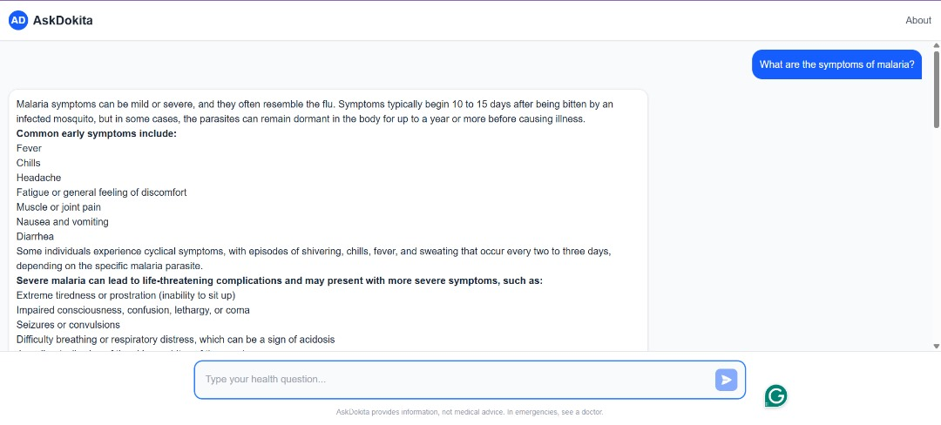
Visual representation of AsDokita

Slide 8
Impact Summary and who it helps
Community health workers
Rural clinics with limited internet
Parents and caregivers needing quick answers
Local health officers during outbreaks
Community health workers
Rural clinics with limited internet
Parents and caregivers needing quick answers
Local health officers during outbreaks
Community health workers
Rural clinics with limited internet
Parents and caregivers needing quick answers
Local health officers during outbreaks
Community health workers
Rural clinics with limited internet
Parents and caregivers needing quick answers
Local health officers during outbreaks
AskDokita reduces misinformation and helps health workers make better decisions on the spot. With reliable guidance delivered to basic phones, we bridge the gap between communities and medical knowledge.
Fewer treatment errors caused by lack of guidelines
Faster response to illnesses like malaria and cholera
Better public health outcomes in underserved communities
Trustworthy, verified information where it matters most
AskDokita will assist
Community health workers
Rural clinics with limited internet
Parents and caregivers needing quick answers
Local health officers during outbreaks

Slide 9
Scalability:
AskDokita can scale across Africa because:
SMS works on any mobile device
New health documents can be added easily to the RAG system
Local languages can be integrated
The system runs on lightweight APIs with minimal infrastructure cost

Slide 10
Thank you
AskDokita makes reliable health information accessible to everyone — no internet, no barriers, just answers.

